Slide 1

Cyclistic bike-share
Capstone project
Presented by: Michael Lorentius Halim
Last updated: January 30th, 2023

Slide 2
Table of content
CONTEXT
Background and objective of the project
WHAT THE DATA TELLS US
The findings of the data
CONCLUSION
Summarizing the result and recommendation

Slide 3
Context Background and objective of the project

Slide 4
context
ABOUT THE COMPANY
Cyclistic bike-share is a sharing service company based in Chicago. The Cyclistic team have recently concluded that annual memberships are more profitable than casual riders.
Lily Moreno, the director of marketing, believes that maximizing the number of annual members will be key to future growth. Moreno has set a clear goal: Design marketing strategies aimed at converting casual riders into annual members.

Slide 5
context
OBJECTIVE
Identify how do annual members and casual riders differ?

Slide 6
What the data tells us the findings of the data

Slide 7
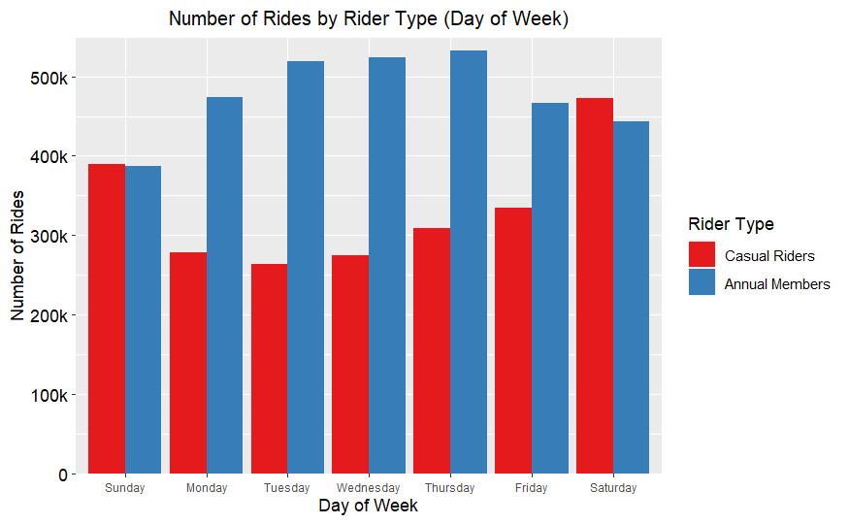
What the data tells us
WEEKLY BIKE RIDES
There were more annual members during the weekdays than casual riders
The number of casual riders increased during the weekends
Overall there were more annual members than casual riders
The data shown is from January – December 2022

Slide 8
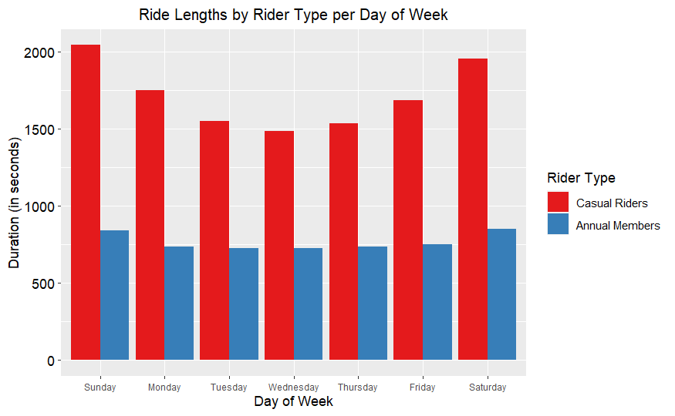
What the data tells us
BIKE LENGTHS BY DAY OF WEEK
Casual riders rode longer distances than annual members with average of 30 minutes
Annual members recorded only 13 minutes in average
The data shown is from January – December 2022

Slide 9
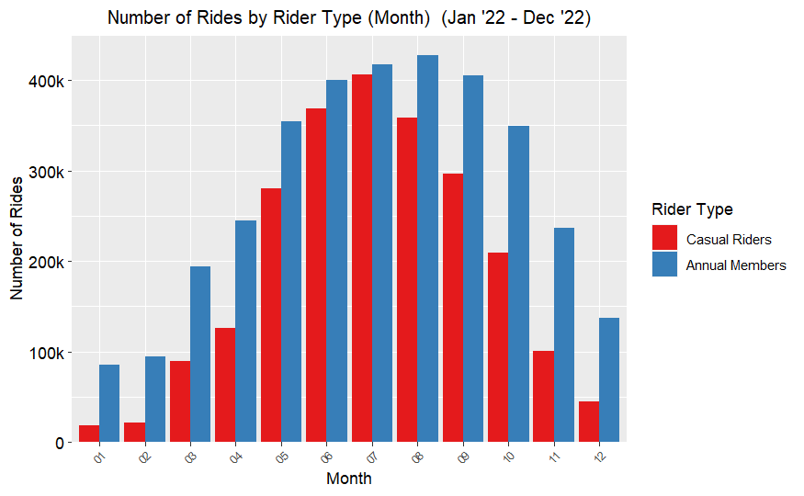
What the data tells us
MONTHLY BIKE RIDES
There were high number of rides during May until September 2022
January, February and December recorded the lowest number of casual riders
There were more annual members than casual riders in each month
The data shown is from January – December 2022

Slide 10
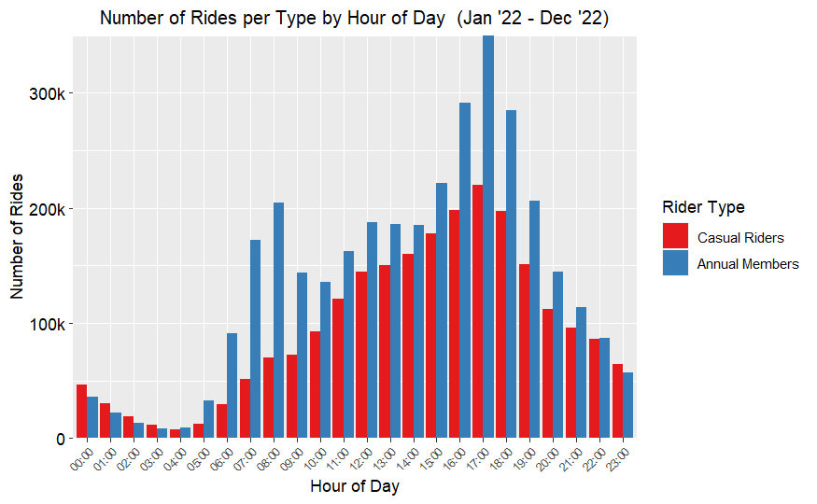
What the data tells us
HOURLY BIKE RIDES
Annual Members used more rides during peak hours
Number of rides from 16:00 to 18:00 are higher than the rest
The highest number of casual riders are at 17:00
The data shown is from January – December 2022

Slide 11
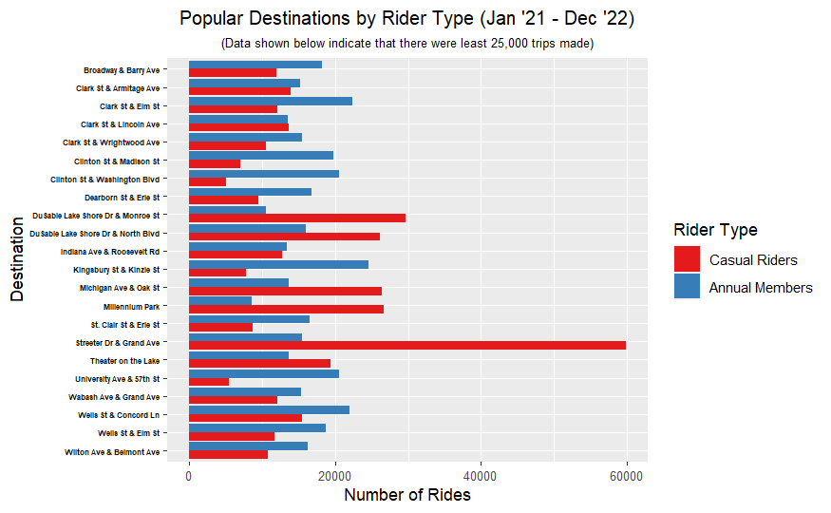
What the data tells us
POPULAR DESTINATIONS
Streeter Dr & Grand Ave station was the most visited by casual riders
Casual riders visited more tourist area that are close to Lake Michigan, Navy Pier, or Millenial Park
Most annual members seem to be locals in Chicago
The data shown is from January – December 2022

Slide 12
CONCLUSION Summarizing the result and recommendation

Slide 13
conclusion
1
2
3
There are differences in the pattern and usage between annual members and casual riders
Casual riders use rides longer than annual members
Season change impacted the number of casual riders
4
5
Most annual members use bikes to travel during working hours
Based on the findings, annual members seem to be locals in Chicago and casual members are seasonal visitors/tourists

Slide 14
CONCLUSION
RECOMMENDATION
Create notifications/email reminders for casual riders to understand the benefits of being annual members. A new membership promotion might help to make casual riders be interested in signing in as annual members.
Digital campaign that show testimonies about how being an annual member is more beneficial than casual rider. Digital advertisement during the high season can also be targeted for casual riders or tourists that prefer to go to popular destinations in Chicago.
Adding a reward system to the annual membership. By visiting certain stations or tourist spot, annual members can get points that can be exchanged for gifts or foods. This system might help bring casual riders to become annual members to gain interesting rewards.

Slide 15
THANK YOU

